Slide 1



PLAGIARISM
Presented By:
PROFESSOR KANU IKECHUKWU ANTHONY (O.S.A)
Department of Philosophy and Religious Studies
Tansian University, Nigeria
@TORMP 2020 International Training on Research Manuscript Drafting and Publishing, Eudoxia Research Centre, India
MAY 16, 2020

Slide 2

PRESENTATION OUTLINE
1
Introduction
Plagiarism: Types and Causes
2
3
Plagiarism and the Law
How to avoid Plagiarism
4
4
Conclusion
5
5
Chart 1

Slide 3
1
Introduction
1
Introduction
Chart 2

Slide 4

INTRODUCTION
Copying during the Ancient and Medieval Times
Works of Aristotle and Thomas Aquinas
Plotinus and Augustine of Hippo
Students copied from teachers
(Plato- Socrates/Aristotle-Plato)
4. Holy Books
Plagiarism in the age of globalization
The world is becoming a global village
There is record
People want to own their work
The economic interpretation of reality
Chart 3

Slide 5
Plagiarism: Types and Causes
1
Introduction
1
2
Chart 4

Slide 6
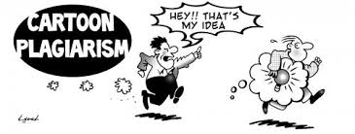
WHAT IS PLAGIARISM?
Plagiarism is an attempt to steal someone else’s work (published or unpublished) with the attempt of passing it off as your own work. This can apply to different things:
1.Idea
2. Picture
3. Song
4. Drama
5. Design
6. Video
Jeff Stahler (2013)
Chart 5

Slide 7
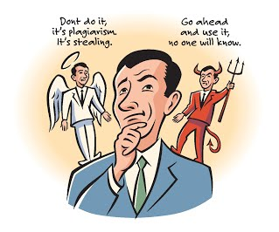
CAUSES OF PLAGIARISM
Lack of Integrity 2. Lack of creativity
3. Laziness 4. Last minute rush which leads to copying
5. Lack of a problem to solve in research
6. Lack of awareness of ethics 7. Lack of awareness of consequences
(Causes of Plagiarism https://sites.google.com/site/flwrldybrd/Causes-of-Plagiarism)
Chart 6

Slide 8
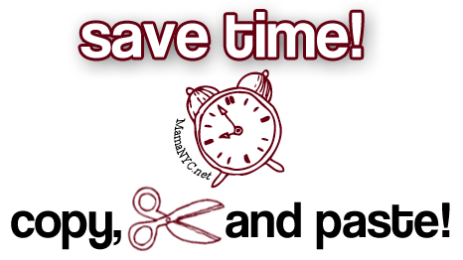
TYPES OF PLAGIARISM
Copying
This involves copying another person’s work and putting your name on it.
2
1
(https://www.plagiarismchecker.net/plagiarism-pictures.php)
Chart 7

Slide 9
An Example of Copying:
“The consequence of the COVID-19 pandemic on the Nigerian economy is one that the nation will have to grapple with for years to come. However, the policy response will go a long way in determining how long it would last. If it is late, weak, or uncoordinated, the devastating consequences would last longer. However, if the response is prompt, strong and coordinated, it would be less devastating. For the policies to be coordinated, it must be multidimensional, bold, and unbound by convention”.
Source:
Kanu A. I. (2020). COVID-19 and the Economy: An African Perspective. Journal of African Studies and Sustainable Development. Vol. 3. No. 2. 33-40
If any writer copies this work word for word without reference to the writer, it is plagiarism
Chart 8

Slide 10
2. Patchwork Plagiarism
This involves taking phrases and clauses from other persons work and weaving it into your own without reference to the original source or writer.
The Source
“The consequence of the COVID-19 pandemic on the Nigerian economy is one that the nation will have to grapple with for years to come. However, the policy response will go a long way in determining how long it would last”.
Example of Patchwork Plagiarism
we may need to understand that the consequences of the COVID-19 pandemic on the Nigerian economy is one that the nation will have to grapple with for the next 10 years
“The consequence of the COVID-19 pandemic on the Nigerian economy is one that the nation will have to grapple with” (Kanu 2020, p. 33)
Chart 9

Slide 11
3. Paraphrasing Plagiarism
This is the type of plagiarism that occurs when a writer summaries another author’s work by changing the words a little and adding synonyms without citing the source, however, still maintaining the thought, structure and style of the author.
“If the response is prompt, strong and coordinated, it would be less devastating. For the policies to be coordinated, it must be multidimensional, bold, and unbound by convention”. (Kanu A. I. (2020). COVID-19 and the Economy: An African Perspective. Journal of African Studies and Sustainable Development. Vol. 3. No. 2. 33-40)
Example
If government responds promptly, in a way that is strong and coordinated, the negative consequences would be minimized. If the policies are to be coordinated, they must be multidimensional, bold, and unbound by convention.
Chart 10

Slide 12
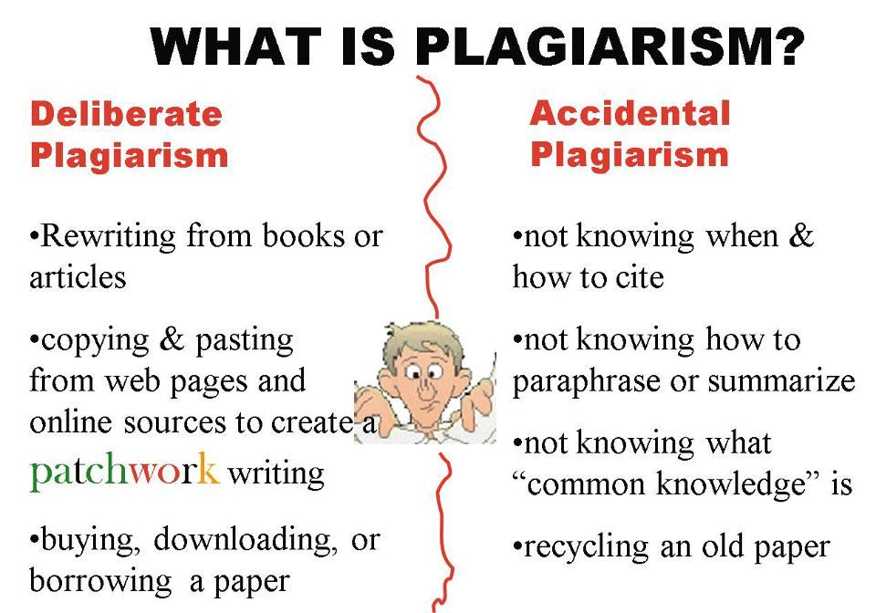
4. Unintentional Plagiarism
This happens when a writer incorrectly quotes or cites the work of another. What make sit plagiarism is that it was not well cited or referenced. Legally, there is no distinction between intentional and unintentional plagiarism.
(
(Pinterest: https://in.pinterest.com/pin/324611085617845471/)
Chart 11

Slide 13
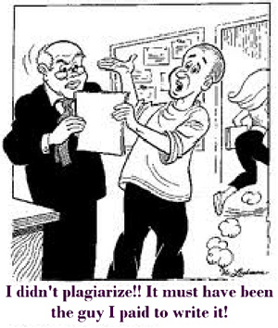
(https://www.plagiarismchecker.net/plagiarism-pictures.php)
Chart 12

Slide 14
Introduction
3
1
Plagiarism and the Law
Chart 13

Slide 15

Copyright
Does copyright mean that you have the right to copy another person’s work? No.
Copyright is a form of legal protection provided by the law to authors of original works.
It gives exclusive right for production, distribution and usage by the author.
You can not use the work without the consent of the author.
Chart 14

Slide 16
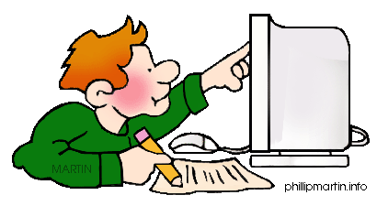
Fair-Use It is a statute under copyright law that allows a person to use limited portion of another’s work that has copyright without taking permission from the author. It is difficult to determine what is a limited portion.
Chart 15
http://internet.phillipmartin.info/internet_plagiarism.htm

Slide 17
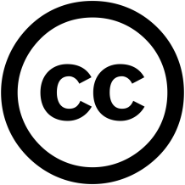




Creative-Commons License It is a public copyright license that enable one to freely distribute of a work with copyrighted. It is used when an author wants to give other people the right to share, use, and build upon a work that they have created.
Attribution (BY)You may use but must attribute the work to the author
Share Alike (SA): You may use, modify, distribute on the same terms. On a different term you consult the copyright holder
Non-Commercial (NC): You may use for none commercial purposes
No Derivatives (ND)You may use as verbatim and not as remixes or derivatives
Chart 16

Slide 18
IMPLICATIONS OF PLAGIARISM
You Risk legal action
Damaged reputation
Your work is unoriginal work
Not being Proud of the work
Original source loses credibility for original idea was stolen
Unfair to others who work hard
You can lose your job
You can be dismissed from school
Chart 17

Slide 19
Introduction
3
1
How to Avoid Plagiarism
Chart 18

Slide 20
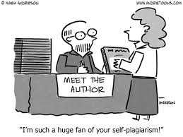
Simply be honest
Quote and cite your sources properly
Use your own work as often as possible
Chart 19

Slide 21
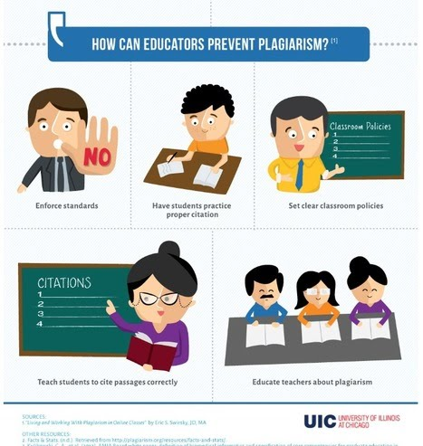
Chart 20

Slide 22
USE PLAGIARISM CHECKERS
Grammarly
DupliChecker
Copyleaks
PlagTracker
Copyscape
Plagiarisma
Paperrater
Search Engine Report
Plagium
Plagscan
Unplug Checker
Chart 21

Slide 23
1
Introduction
5
Conclusion
Chart 22

Slide 24
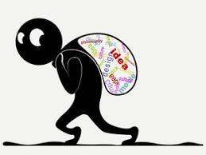
Conclusion
Plagiarism is a crime and does not allow a writer the opportunity to grow in the art of thinking and writing. It is the problem of the personal morale of each person, because it is a willful action of the plagiarist.
(https://www.plagiarismchecker.net/plagiarism-pictures.php)
( PNGWING, https://www.pngwing.com/en/search?q=plagiarism)
Chart 23

Slide 25
References
Jeff Stahler (2013), Visualizing the Immorality of Plagiarism. ttps://breenablog.wordpress.com/2013/11/05/visualizing-the-immorality-of-plagiarism
Kanu A. I. (2020). COVID-19 and the Economy: An African Perspective. Journal of African Studies and Sustainable Development. Vol. 3. No. 2. 33-40
Chart 24

